Slide 1

LIVING HISTORY
SWE 574
SOFTWARE DEVELOPMENT AS A TEAM
FALL 2014

Slide 2
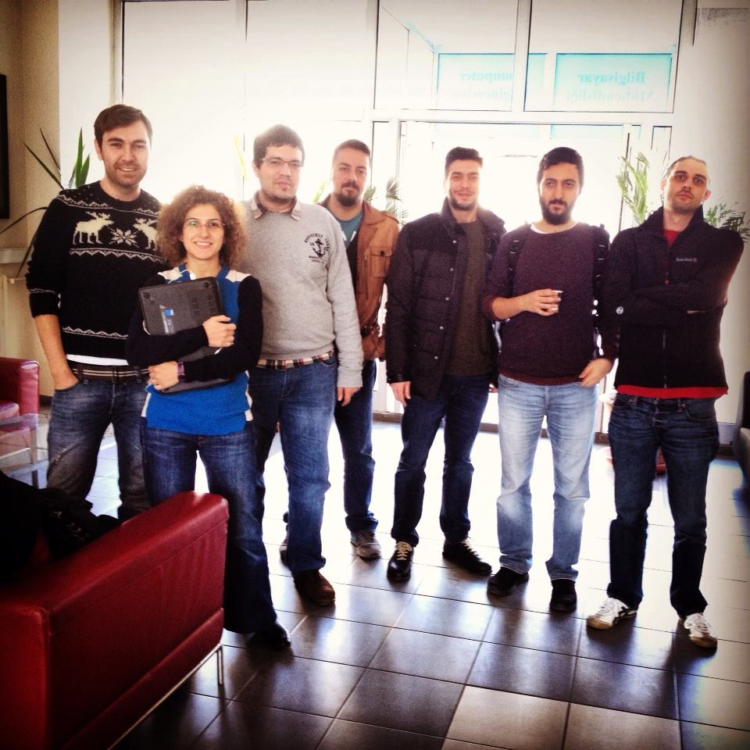
SWE 574
2014 FALL TEAM

Slide 3




SUZAN ÜSKÜDARLI
Customer
ERMAN ALPEREN
Android Developer
ESER GÖKÇE KARACA
Project Manager
Currently working at Backend
MICHAEL BOYMAN Android Developer
İLKER KARAMANLI
Java Guru
Backend Developer
HALİL BİLİR
Fastest Developer Ever
ONAT TANRIÖVER
Database Designer
KAZIM ÖZYILMAZ
Developer
Currently working at supporting Integration

Slide 4

MILESTONE RESULTS
Milestone I "Add and Show Memory on Client" (17.11.2014)
Create Mockup Data on Client (10 Memory) COMPLETED ON TIME
Finalize add memory forms/mechanism COMPLETED ON TIME
Finalize show memory form/mechanism COMPLETED ON TIME
Milestone I Deliverables Document COMPLETED ON TIME
Milestone II "Signup and Login on Client " (01.12.2014)
Add Signup forms on Client demo COMPLETED ON TIME
Add Login forms on Client demo COMPLETED ON TIME

Slide 5
All Tasks including Additional Issues for Milestone II (01.12.2014)
Push initial backend code (İlker): In Progress
First version of memory crawler (Kazim): In Progress
Test 1st release of web client (Eser): Complete
Fix initial resolution problems for Android Client
(Erman): Complete
Deploy Cordova to an Android (Michael): Complete
Create sign-in page & form (Halil): Complete
Create sign-up page & form (Halil): Complete
Review the initial database design (Eser): Complete
Review of RSD version 5.0 (Onat): Complete

Slide 6
MILESTONE RESULTS
Milestone III "Android version of Client" (08.12.2014)
Android client development COMPLETED ON TIME
Client Demonstration COMPLETED ON TIME
(USING NEXUS TABLET)
Awaiting Backend to be completed for verification of all functionalities.

Slide 7
MILESTONE RESULTS
Milestone IV "Client with Backend" (15.12.2014)
Database Design COMPLETED ON TIME
Remove all Mockup Data from Client COMPLETED ON TIME
Move all Mockup Data to Server COMPLETED ON TIME
JSON format agreement COMPLETED ON TIME
JSON query type agreement COMPLETED ON TIME
The client-server integration is not complete. Our goal is to complete it until 22.12.2014.

Slide 8
MILESTONE RESULTS
Milestone V "Client, Server
& Database in Harmony" (22.12.2014)
Remove all Mockup Data from Client and Server COMPLETED ON TIME
Deployment of Database, Server & Client
onto the School's environment. COMPLETED ON TIME
Transaction/Query design COMPLETED ON TIME
Server and Database
communication implementation COMPLETED ON TIME
We have reached our goal mentioned on the above slide. The integration has been completed on 20.12.2014.
But there are some missing functionalities which have to be completed to meet all requirements.

Slide 9
MILESTONE & ISSUE EVALUATIONS
Milestone I "Add and Show Memory on Client" (17.11.2014)
No issues are detected on the web client.
Adding and showing memory functions are working fine.
Milestone II "Signup and Login on Client " (01.12.2014)
Sign-up and login forms have been created.
Login function is not operating yet.
Android client version is crashing on the device. Emulator has been used this week. This issue will be resolved until 08.12.2014 (Milestone & Deadline for Android client)
Resolution issues have been fixed for Android client.
Backend operations have started by creating the code to respond to Json requests.
Reviews have been performed for: - Initial database design
- RSD ver 5.0
Data scraper has been picked up for use instead of data crawler.

Slide 10
MILESTONE & ISSUE EVALUATIONS
Milestone III "Android Version of Client" (08.12.2014)
Android client version of the application has been presented using a Nexus Tablet device.
Verification of all existing functionality is not complete yet since the backend side has to be completed for this.
Except the functionality awaiting backend side, everything is OK on the Android client and the resolution problems are solved.

Slide 11
MILESTONE & ISSUE EVALUATIONS
Milestone IV "Client with Backend" (15.12.2014)
Database design & creation is complete.
Table creations are complete. (place, memory, user)
Data inserting onto the place table and memory table is complete.
Getting data from database using JSON communication was problematic initially as there were some connection driver problems. This connection problem has been resolved by finding the correct driver.
Initial database design has been modified according to the changing requirements from the client developer. Place_id has been selected as the primary key . The place & memory tables will be connected this way.
JSON communication has been used successfully to respond to client requests. The application is able to get the memories from the database and give response to the client requesting the data. The data is returned as a JSON object.
«List all memories» , «get memory », « create user », «get user» functionalities are complete.
Team has decided to make some changes on the API between client and server.

Slide 12
1. REST APIs to be changed as below: List all memories GET http://swe.cmpe.boun.edu.tr:8080/LivingHistoryRestService/rest/memory/get Create memory GET|POST http://swe.cmpe.boun.edu.tr:8080/LivingHistoryRestService/rest/memory/create Respond to memory GET|POST http://swe.cmpe.boun.edu.tr:8080/LivingHistoryRestService/rest/memory/response Filter memories GET http://swe.cmpe.boun.edu.tr:8080/LivingHistoryRestService/rest/memory/filter Retrieve user GET http://swe.cmpe.boun.edu.tr:8080/LivingHistoryRestService/rest/user/get Create user GET|POST http://swe.cmpe.boun.edu.tr:8080/LivingHistoryRestService/rest/user/create Reset password GET|POST http://swe.cmpe.boun.edu.tr:8080/LivingHistoryRestService/rest/user/reset
MILESTONE & ISSUE EVALUATIONS

Slide 13
2. A RESTFUL function is needed to add new places. ADD_PLACE should be done before the ADD_MEMORY request. Add place GET|POST http://swe.cmpe.boun.edu.tr:8080/LivingHistoryRestService/rest/place/add 3. place_id is the PRIMARY_KEY for db. It connects PLACE & MEMORY tables. 4. The date added to the memory should be sent in the below format. This should be arranged on the client side. DATE - format YYYY-MM-DD DATETIME - format: YYYY-MM-DD HH:MI:SS 5. In order to make adding and searching easier, the client should send the tags as a single string that includes words separated by a comma. Searching will be much more simple in this way.
MILESTONE & ISSUE EVALUATIONS

Slide 14
MILESTONE & ISSUE EVALUATIONS
Milestone V " Client, Server & Database in Harmony" (22.12.2014)
A query for filter operations has been created on database side.
Various issues have been faced regarding the tags. These were resolved by updating the code on the backend side.
The code on the client side has been modified for places. In order to fit these changes, backend side has been modified as well.
The required code has been written in order to let the users add a memory onto multiple locations.
The integration between client, server and database has been implemented completely.
The current version of the application has been merged onto the project’s google code pages.
Application has been deployed onto the school’s environment. Application is running successfully right now. The link is: http://swe574.cmpe.boun.edu.tr:8080/LivingHistoryRestService/www/index.html

Slide 15
MILESTONE & ISSUE EVALUATIONS
The following functionalities are working properly on the application:
Registering as a new user
Logging into the application
Adding a new memory (adding a location is a prerequisite)
Adding a year, month, day, hour and minute information for a memory
Searching for a memory according to tag and date information
Uploading an image for the memory being added
Adding a memory onto more than 1 locations
The following functionalities are missing and will be completed:
Responding to a memory
Sending email for the “Forgot Password?” status (We have no chance to add this functionality right now since the server in the school does not connect to Internet. If internet access is provided, we can add this functionality. )

Slide 16
MILESTONE & ISSUE EVALUATIONS
Milestone VI "Final Integration" (05.01.2015)
Semantic search has been added to the queries on database side.
Database design has been updated to include the user response functionality.
User response functionality has been added to the application. Predefined responses have been used.
Web client is tested & runnng successfully.
Android client is tested & running successfully.
Final integration between client, backend and database has been implemented once again after the modifications on database, server and client sides are complete.
The final version of the application has been merged onto the project’s site on Google Code.
The deployment of the application onto the aws server has been performed. Application is running successfully and can be accessed using the below link:
http://ec2-54-72-10-88.eu-west-1.compute.amazonaws.com:8080/LivingHistoryRestService/www/index.html#!/

